Slide 1
Vendor Performance Analysis

Slide 2
Business Problem
Effective inventory and sales management are critical for optimizing profitability in the retail and wholesale industry. Companies need to ensure that they are not incurring losses due to inefficient pricing, poor inventory turnover, or vendor dependency. The goal of this analysis is to:
Identify underperforming brands that require promotional or pricing adjustments.
Determine top vendors contributing to sales and gross profit.
Analyze the impact of bulk purchasing on unit costs.
Assess inventory turnover to reduce holding costs and improve efficiency.
Investigate the profitability variance between high-performing andlow-performing vendors.

Slide 3
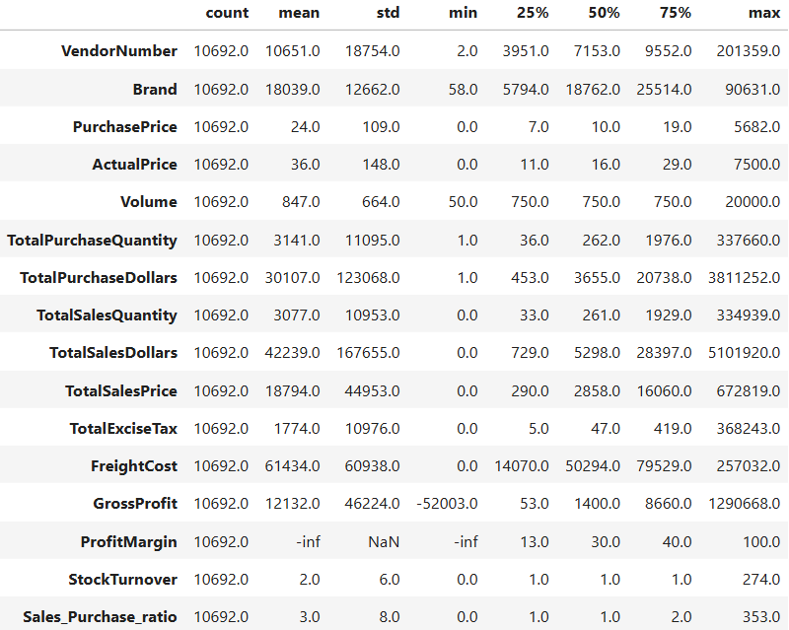
Summary Statistics:

Slide 4
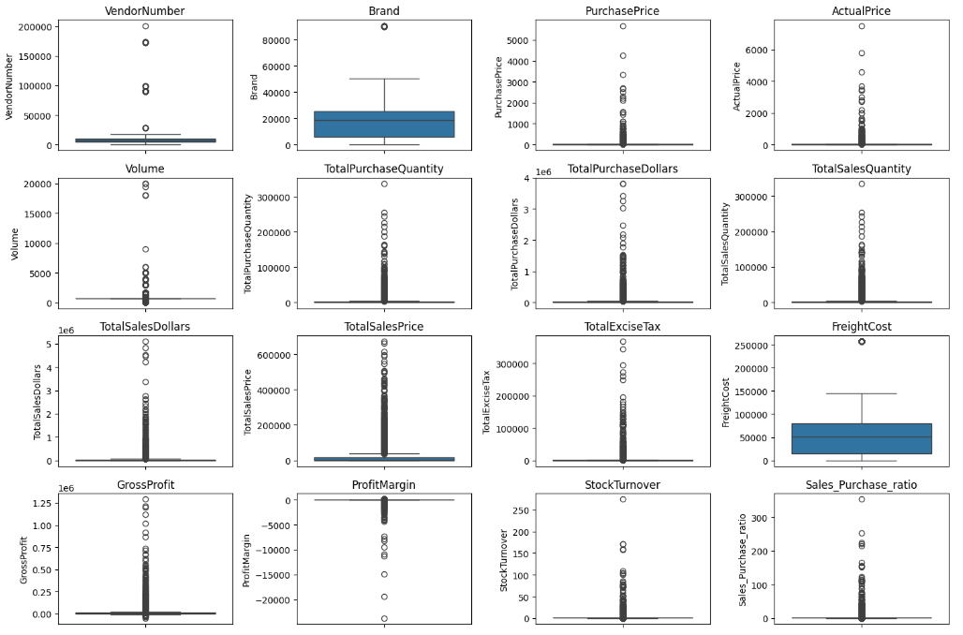

Slide 5
Summary Statistics Insights:
Negative & Zero values:
Gross Profit: Min value is $-52002.78, indicating losses. Some products or transactions may be selling at a loss due to high costs or selling at discounts lower than the purchase price.
Profit Margin: Min is -infinity, which suggests cases where revenue is zero even lower than costs.
Total Sales Quantity & Sales Dollars: Min values are 0, meaning some products were purchased but never sold. These could be slow-moving or obsolute stock.
Outliers Indicated by High Standard Deviations:
Purchase & Actual Prices: The max values (5681.81 & 7499.99) are significantly higher than the mean (24.39 & 35.64), indicating potential premium products.
Freight Cost: Huge variation 0.09 to 257032.07, suggests logistic inefficiencies, bulk shipments or erratic shipping costs across different products.
Stock Turnover: Ranges from 0 to 274.5, implying some products sell extremely fast while others remain in stock indefinitely. Value >1 indicates that Sold quantity for that product is higher than purchased quantity due to either sales are being fulfilled from older stock leading to inventory inefficiencies.

Slide 6
Data Filtering
To enhance the reliability of the insights, we removed inconsistent data points where:
Gross Profit ≤ 0 (to exclude transactions leading to losses.)
Profit Margin ≤ 0 (to ensure analysis focuses on profitable transactions.)
Total Sales Quantity = 0 (to eliminate inventory that was never sold.)
Correlation Insights:

Slide 7
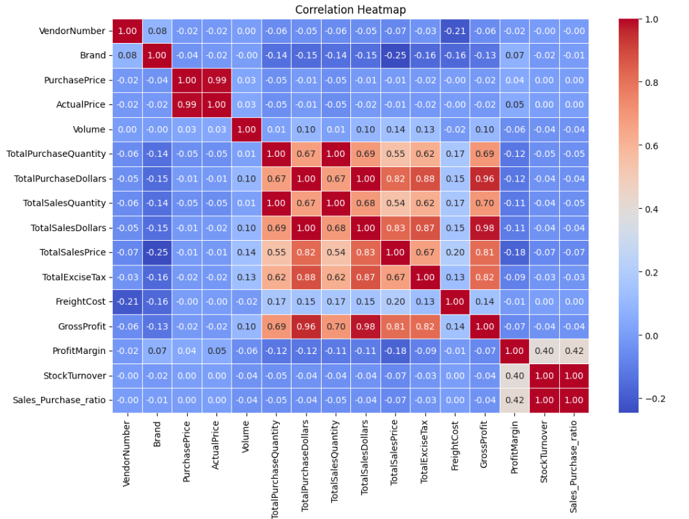

Slide 8
Purchase Price v/s TotalSalesDollars and GrossProfit: Weak correlations (-0.012 and -0.016), indicating that price variations do not significantly impact sales revenue or profit.
Total Purchase Quantity v/s Total Sales Quantity: Strong correlation (0.999), confirming efficient inventory turnover.
Profit Margin v/s Total Sales Price: Negative correlation (-0.179) suggests that as sales price increases, margins decrease, possibly due to competitive pricing pressure.
Stock Turnover v/s GrossProfit & ProfitMargin: Weak negative correlations (-0.038 & -0.055), indicating that faster turnover does not necessarily result in higher profitability.

Slide 9
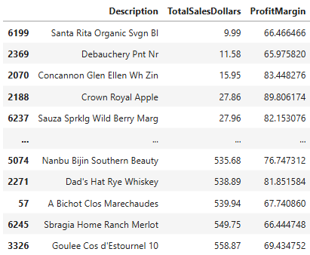
Research Questions & Key Findings
1. Brands for Promotional or Pricing Adjustments

Slide 10
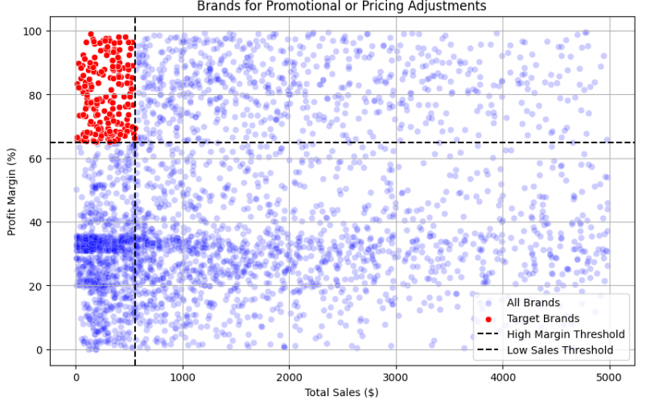
198 brands exhibit lower sales but higher profit margins, which could benefit from targeted marketing, promotions, or price optimizations to increase volume without compromising profitability.

Slide 11
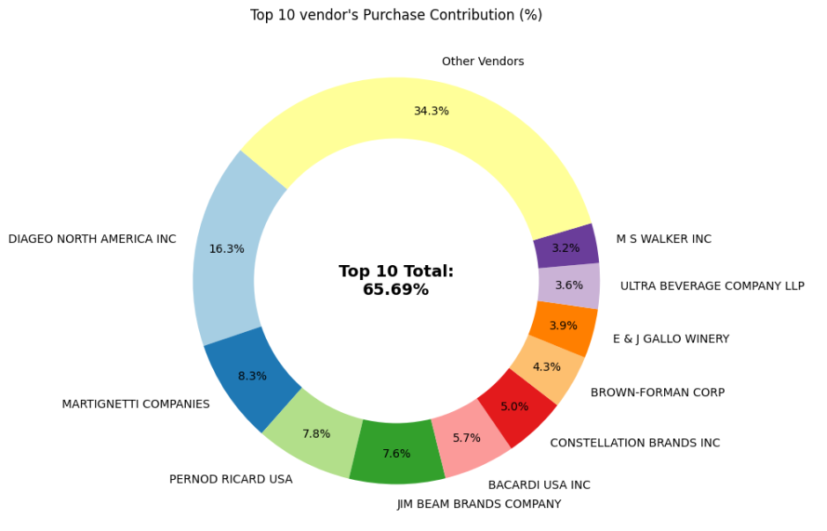
2. Top Vendors by Sales & Purchase Contribution
The top 10 Vendors contribute 65.69% of total purchases, while remaining vendors contribute only 34.31%. This over-reliance on a few vendors may introduce risks such as supply chain disruptions, indicating a need for diversification.

Slide 12
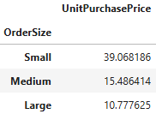
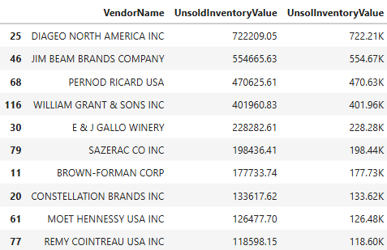
3. Impact of Bulk Purchasing on Cost Savings
Vendors buying in large quantities receive a 72% lower unit cost ($10.78 per unit v/s higher unit costs in small orders.)
Bulk pricing strategies encourage large orders, increasing total sales while maintaining profitability.
4. Identifying Vendors with Low Inventory Turnover
Total Unsold Inventory Capital: $2.71M
Slow-moving inventory increases storage costs, reduces cash flow efficiency and affects overall profitability.
Identifying vendors with low inventory turnover enables better stock management , minimizing financial strain.

Slide 13
5. Profit Margin Comparison: High vs low-Performing vendors
Top Vendors Profit Margin (95% CI): (28.99%, 33.36%), Mean: 31.18%
Low Vendors Profit Margin (95% CI): (39.06%, 44.07%), Mean: 41.57%
Low-performing vendors maintain higher margins, but struggle with sales volumes, indicating potential pricing inefficiencies or market reach issues.
Actionable Insights:
Top-performing vendors: Optimize profitability by adjusting pricing, reducing operational costs, or offering bundled promotions.
Low-performing vendors: Improve marketing efforts, optimize pricing strategies and enhance distribution networks.

Slide 14
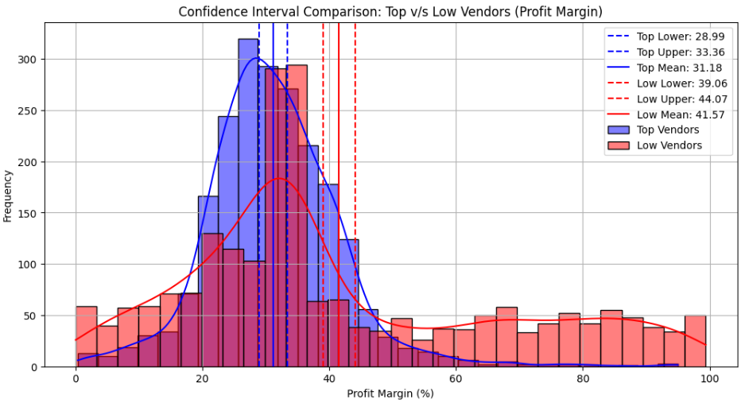

Slide 15
6. Statistical validation of Profit Margin Differences
Hypothesis Testing:
H0 (Null Hypothesis): There is no significant difference in the mean profit margins of top and low performing vendors.
H1 (Alternate Hypothesis): The mean profit margins of top-performing and low- performing vendors are significantly different.
Result: The null hypothesis rejected, confirming that the two groups operate under distinctly different profitability models.
Implication: High-margin vendors may benefit from better pricing strategies, while top-selling vendors could focus on cost efficiency.

Slide 16
Final Recommendatons:
Re-evaluate pricing for low-sales, high-margin brands to boost sales volume without sacrificing profitability.
Diversify vendor partnerships to reduce dependency on a few suppliers and mitigate supply chain risks.
Leverage bulk purchasing advantages to maintain competitve pricing while optimizing inventory management.
Optimize slow-moving inventory by adjusting purchase quantities, launching clearance sales. or revising storage strategies.
Enhance marketing and distribution strategies for low-performing vendors to drive higher sales volumes without compromising profit margins.
By implementing these recommendations, the company can achieve sustainable profitability, mitigate risks, and enhance overall operational efficiency.

